Slide 1
IoT BASED HOME APPLIANCE CONTROL USING ANDROID APPLICATION
AITM Collage
Dept of Electronics & Communication

Slide 2
Name of the Group Members
NAME
USN
Rahul S
2AG19EC018
Ashish B
2AG19EC005
Pavan G
2AG19EC014
Name of the Guide
Project Co-Ordinator
Prof.Goutam K
Prof.Sriram K

Slide 3
CONTENT
Introduction
Literature survey
Objectives
Methodology
Possible outcomes
References

Slide 4
ABSTRACT:
This system is designed to assist and provide support in order to fulfill the needs of elderly and disabled in home. Automation of the surrounding environment of a modern human being allows increasing his work efficiency and comfort.
There has been a significant development in the area of an individual’s routine tasks and those can be automated. In the present times, we can find most of the people clinging to their mobile phones and smart devices throughout the day.
Hence with the help of his companion – a mobile phone, some daily household tasks can be accomplished by personifying the use of the mobile phone. Analyzing the current smart phone market, most users are opting for Android based phones.
Home Automation System (HAS) has been designed for mobile phones having Android platform to automate an Bluetooth interfaced Arduino which controls a number of home appliances like lights, fans, bulbs and many more using on/off relay.

Slide 5
INTRODUCTION:
Today’s homes require sophistication control in its different gadgets which are basically electronic appliances. This has revolutionized the area of home automation with respect to an increased level of affordability and simplicity through the integration of home appliances with smart phone and tablet connectivity.
Smart phones are already feature-perfect and can be made to communicate to any other devices in an ad hoc network with a connectivity options like Bluetooth. With the advent of mobile phones, Mobile applications development has seen a major outbreak.
Utilizing the opportunity of automating tasks for a smart home, mobile phone commonly found in normal household can be joined in a temporary network inside a home with the electronic equipment.
Android, by Google Inc. provides the platform for the development of the mobile applications for the Android devices.

Slide 6
2.LITERATURE SURVEY:
In Bluetooth based home automation system the home appliances are connected to the Arduino BT board at input output ports using relay.
The program of Arduino BT board is based on high level interactive C language of microcontrollers; the connection is made via Bluetooth. The password protection is provided so only authorized user is allowed to access the appliances.
The Bluetooth connection is established between Arduino BT board and phone for wireless communication. In this system the python script is used and it can install on any of the Symbian OS environment, it is portable
One circuit is designed and implemented for receiving the feedback from the phone, which indicate the status of the device

Slide 7
3.OBJECTIVES:
The main objective of this project is to develop a home automation system using an Arduino board with Bluetooth being remotely controlled by any Android OS smart phone. As technology is advancing so houses are also getting smarter.
The objective of this project is to implement a low cost, reliable and scalable home automations system that can be used to remotely switch on or off any house hold applications.
Using micro controller to achieve hardware simplicity low cost short messaging service for feedback and voice dail from any phase to toggle the switch state.
One of the objectives of this project is also to get us a smart automation and low-cost project.

Slide 8
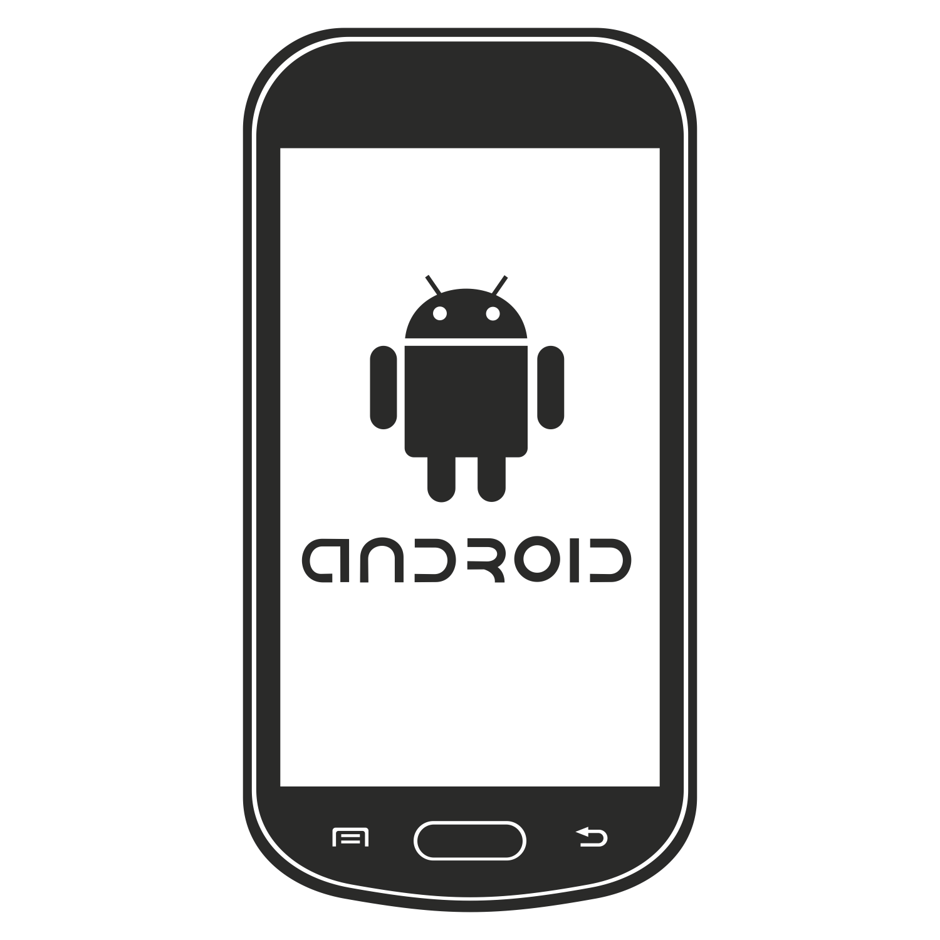
4.METHODOLOGY:
Block Diagram
STREET LIGHT
Power supply
Node MCU
Hospital
Home

Slide 9
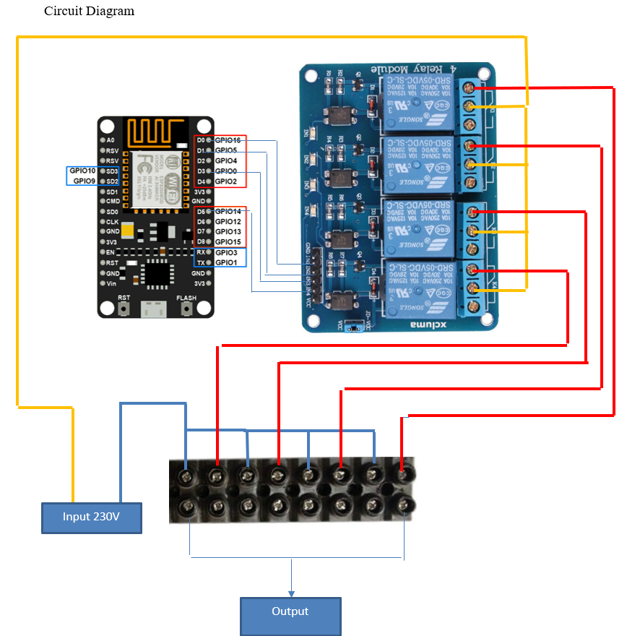

Slide 10
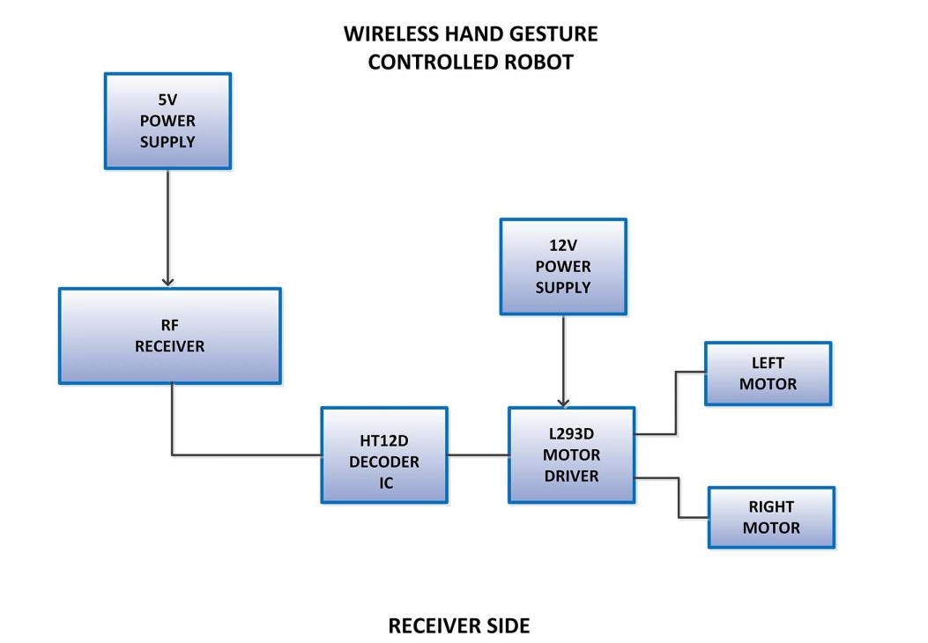
Component Required 1. Node MCU(esp8266) 2. 4 Channel relay 3. Breadboard 4. Jumper wires 5. Connecting cable 6. AC fan 7. AC bulb 8. Bulb holder 9. Wire 10. AC supply 11. power supply

Slide 11
Advantages:
Since It is wireless, it can be controlled from anywhere from the network.
Other devices up to 8 numbers can be added.
Single point control for all the devices.
Can be accessed by anyone who has the authorization.
DISADVANTAGES:
Since it is IoT, Network availability is important.
After a certain range, other equipment to increase the range have to be added.
Only authorized personal will be allowed to operate

Slide 12
5.POSSIBLE OUTCOMES:
According to the proposed plan the final outcome of this paper leads to the development of a home automation.
Through this project, an automated system has been created so that we can easily control home appliances like as light, fan, AC, Water motor, Door lock, etc.
When power is supplied to Arduino board, the room temperature and water level are displayed on the LCD display.
After giving power supply (5V), at first connect the Bluetooth module with android application. If we want light turn on just press the “Light On” button on the application then the light will turn on. It will work another light and fan also by pressing another button. If we want the door open or close, then press “Door” button in the application.

Slide 13
6 . REFERENCES:
N. Sriskanthan and Tan Karand. “Bluetooth Based Home Automation System”. Journal of Microprocessors and Microsystems, Vol. 26, pp.281289, 2002.
Muhammad Izhar Ramli, Mohd Helmy Abd Wahab, Nabihah, “TOWARDS SMART HOME: CONTROL ELECTRICAL DEVICES ONLINE” ,Nornabihah Ahmad International Conference on Science and Technology: Application in Industry and Education (2006).
A.K. Kasim, A. RaheemBluetooth based smart home automation system using Arduino UNO microcontrollerAl-Mansour J., 27 (2017), p. 139View Record in ScopusGoogle Scholar.
A.B.H. Amirah, H.I.I. Mohamad, K ChanBluetooth based home automation system using an android phoneJ. Teknologi (Sci. Eng.), 70 (2014), pp. 57-61Google Scholar
B. Yuksekkaya, A.A. Kayalar, M.B. Tosun, M.K. Ozcan, A.Z. AlkarA GSM, internet and speech controlled wireless interactive home automation systemIEEE Trans. Cons. Electr., 52 (3) (2006), pp. 837-843View Record in ScopusGoogle Scholar

Slide 14
THANK YOU

